Slide 1


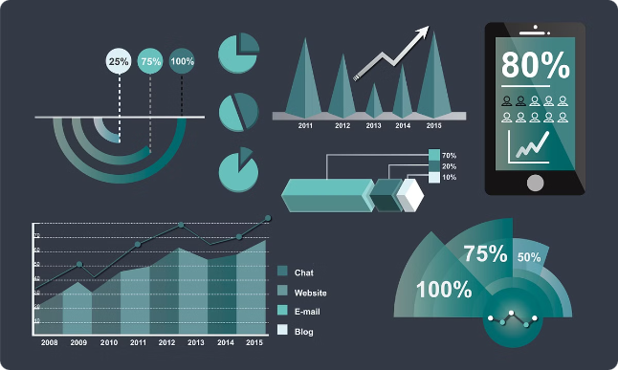

Employee Data Analysis
Harnessing the power of data to gain valuable insights into your workforce. This analysis helps to identify trends and patterns, improve decision-making, and optimize your organization's performance.
SA
by Saraswathi A Saraswathi A

Slide 2

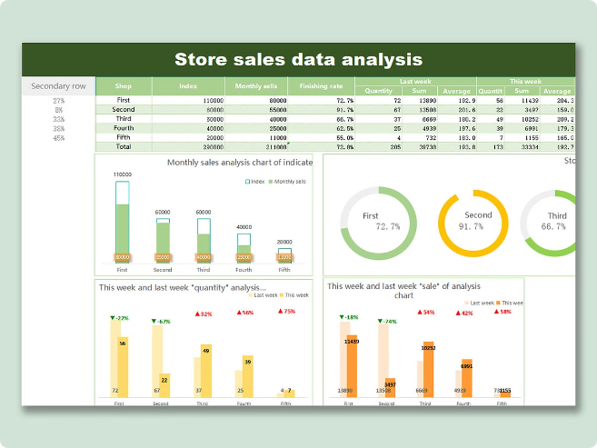
Project Overview
This project focuses on analyzing employee data collected from various sources within your organization. We aim to uncover valuable insights that can improve employee engagement, retention, and productivity.
1
Data Sources
2
Key Metrics
The project utilizes various data sources, such as employee surveys, performance reviews, attendance records, and training completion data.
We'll be analyzing key metrics such as employee satisfaction, turnover rate, performance ratings, and training effectiveness.
3
Target Audience
4
Project Goals
The insights generated from this analysis will be shared with stakeholders, including HR professionals, managers, and executives.
The primary goal is to provide actionable insights that can support data-driven decision-making and improve employee performance.

Slide 3
End Users
The analysis targets key stakeholders who can benefit from the insights generated. These individuals are responsible for making informed decisions about various aspects of employee management.
HR Professionals
Managers
Executives
Gain insights into employee engagement, identify areas for improvement in HR policies and practices, and develop targeted training programs.
Understand their team's performance, identify potential issues, and implement strategies to improve productivity and morale.
Track overall workforce trends, assess the impact of company initiatives, and make strategic decisions about talent acquisition, development, and retention.

Slide 4

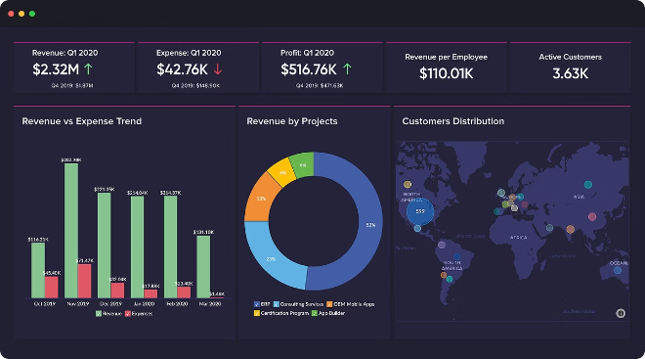
Our Solution and Proposition
We leverage a combination of data analysis techniques, including descriptive statistics, regression analysis, and data visualization, to provide actionable insights. This approach helps to identify trends, patterns, and relationships within the data, empowering stakeholders to make informed decisions.
Data Cleaning and Preparation
Descriptive Analysis
We ensure data accuracy and completeness by cleaning and preparing the data for analysis.
We calculate summary statistics to understand the distribution of key variables and identify potential outliers.
Regression Analysis
Data Visualization
We use regression models to identify relationships between different variables and predict future outcomes.
We create visually appealing charts and graphs to communicate complex insights in a clear and concise manner.

Slide 5

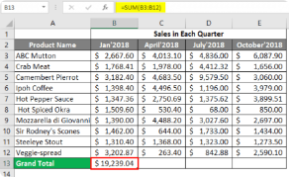
Dataset Description
The dataset contains a wealth of information about your employees. It includes demographic data, performance reviews, salary information, training records, and feedback collected from employee surveys.
Variable
Description
Employee ID
Unique identifier for each employee
Name
Employee's full name
Department
Department the employee belongs to
Job Title
Employee's job role within the organization
Years of Experience
Number of years the employee has worked in the organization
Performance Rating
Numerical rating reflecting the employee's performance
Salary
Employee's annual salary
Training Completion Status
Indicates whether the employee has completed required training programs
Employee Survey Feedback
Textual feedback provided by the employee on various aspects of work experience

Slide 6

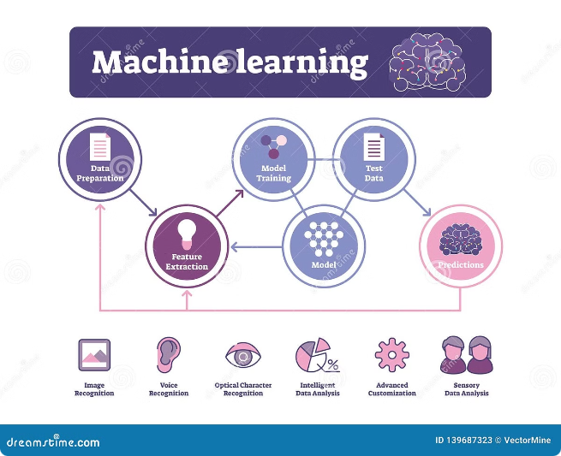



Modeling Approach
We utilize a combination of statistical techniques and machine learning algorithms to analyze the data and extract valuable insights.
Descriptive Analysis
We calculate measures like mean, median, standard deviation, and correlation coefficients to understand the distribution of key variables.
Regression Analysis
We employ regression models to identify relationships between employee attributes and performance outcomes, such as salary or promotion.
Clustering Analysis
We use clustering algorithms to identify groups of employees with similar characteristics, facilitating targeted interventions and development programs.

Slide 7






Result and Discussion
The analysis reveals several key findings that can be used to improve employee engagement, retention, and productivity. These insights are discussed and presented in a comprehensive report.
Employee Satisfaction
Employee Retention
The analysis identifies key factors driving employee satisfaction, enabling targeted initiatives to improve employee morale and engagement.
We identify factors contributing to employee turnover and develop strategies to reduce attrition and retain valuable talent.
Employee Performance
Training Effectiveness
The analysis highlights factors influencing employee performance, enabling the development of targeted training programs and performance improvement strategies.
We evaluate the effectiveness of existing training programs and recommend improvements to enhance employee skills and knowledge.

Slide 8

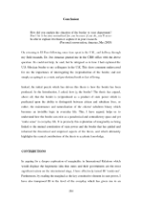
Conclusion
By analyzing employee data, we have gained valuable insights into the workforce and identified areas for improvement. These insights can be used to make data-driven decisions that enhance employee engagement, retention, and productivity, ultimately contributing to the success of the organization.
Continuous Improvement
Data-Driven Insights
Regular data analysis and monitoring will ensure continuous improvement in employee management practices and organizational performance.
The analysis provides a clear understanding of employee demographics, performance, and satisfaction.
1
2
3
Actionable Recommendations
The findings guide strategic initiatives to address key areas for improvement, such as training, compensation, and employee engagement.

